Slide 1
Distance Learning and Our Consortium
Southeast interactive Long distance learning (SILDL)

Slide 2
History (1997 – Present)
DTG Telecommunications – Cooperative Effort between telephone company and area schools.
DTG, Avon, Bon Homme, Gayville-Volin, Irene, Wakonda, Viborg, Hurley, Parker, Tea (Later), Canton, Beresford, USD and Children’s Hospital and School.
Funded through a RUS Grant – Department of Agriculture Rural Utilities Service. - Secured this grant twice

Slide 3
Directors
Larry Lickfelt – University of South Dakota (Previous: Bon Homme Superintendent)
Don Versteeg – University of South Dakota (Prevous: Canton Math Teacher)
Jason Selchert – Gayville-Volin School District (Technology Coordinator and Superintendent) 2012-Present

Slide 4
Fiscal Agent – Southeast Area Cooperative 1998-Present
Advisory Board – One Superintendent Each School
Determines Offerings
Sets Policy
Adopts Budget
Sets Membership Fees

Slide 5
Membership
Alcester-Hudson School District Prospective
Arlington School District *Beresford
Avon School District
Centerville School District (2014-2015) Clark School District
Estelline
Gayville-Volin School District
Irene-Wakonda School District
Rutland School District
Sioux Valley School District
Tea Area School District
Viborg-Hurley School District

Slide 6
College Offerings
Fall 2013
ENG 103 Composition I (H5) MWF 7:00-7:50 am
ENG 103 Composition I (H5a) TR 9:00—10:15 am
ENG 103 Composition I (H5b) TR 1:00—2:15 pm
MTH 150 College Algebra MWRF 8:00-8:50 am
PSY 101 Intro to Psychology MWF 9:00-9:50 am
CJU 133 Intro to Criminal Justice MWF 1:00-1:50 pm
MUS 100 Music Theory MWF 2:00-2:50 pm
POS 120 American Government MWF 3:00-3:50 pm
Spring 2013
ENG 210 Literature I (H5) MWF 7:00-7:50 am
ENG 210 Literature I (H5a) TR 9:00—10:15 am
ENG 210 Literature I(H5b) TR 1:00—2:15 pm
MTH 180 Pre-Calculus MWRF 8:00-8:50 am
PSY 101 Intro to Sociology MWF 9:00-9:50 am
Pharmacology and Nutrition - TBA

Slide 7
High School Offerings
2013-2014 Offerings
Agribusiness
Anatomy and Physiology
Natural History
Physics
Comprehensive Creative Art
Accounting I and II
Algebra I
Digital Media
Service Learning
Spanish I and II

Slide 8
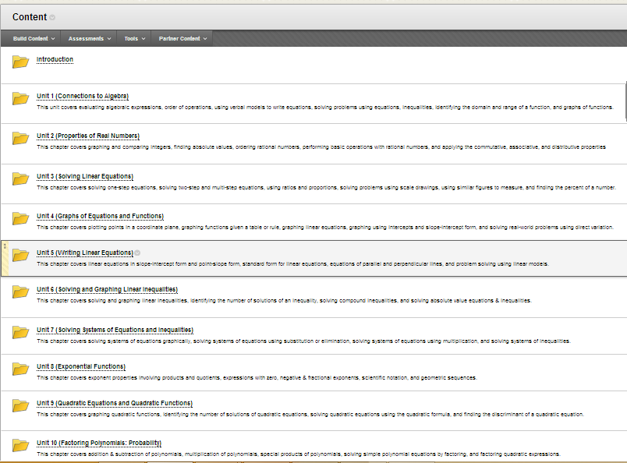
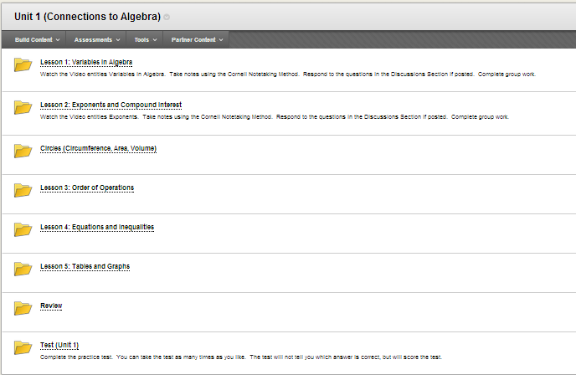
Mass Customized Learning Structure

